Slide 1



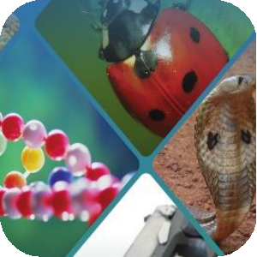
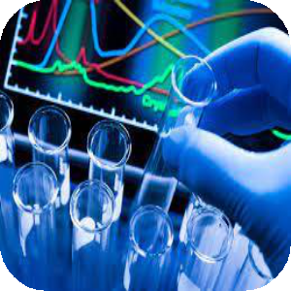



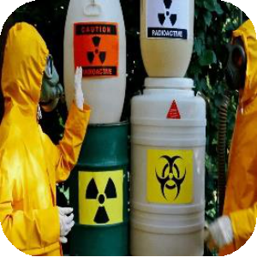

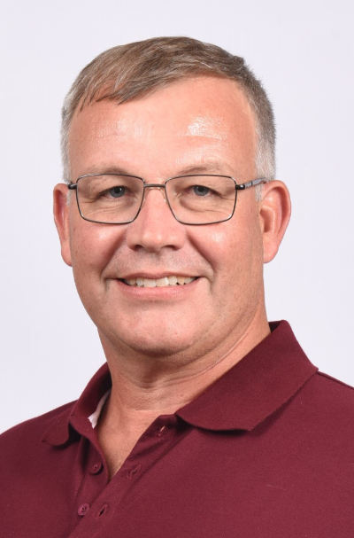
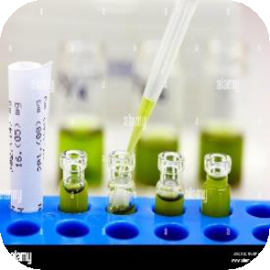

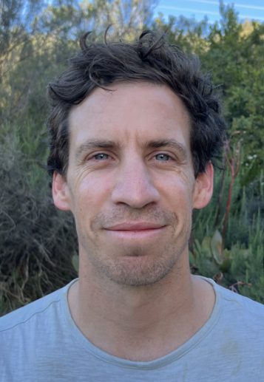
.
    This presentation describes two important topics that highlight emerging approaches and ongoing challenges in clinical toxicology practice. The first presentation, Point-of-Care Ultrasound in Clinical Toxicology, explores the application of bedside ultrasound as a diagnostic and monitoring tool in poisoned patients, demonstrating its value in supporting rapid clinical decision-making and improving patient assessment. The second presentation, Organophosphate Poisoning in Children: What We Don’t Know, examines current knowledge gaps surrounding the epidemiology, clinical presentation, management, and long-term outcomes of paediatric organophosphate poisoning, emphasizing the need for further research to guide evidence-based care. Together, these presentations showcase the evolving role of innovative diagnostic techniques and research in enhancing the management of toxicological emergencies.
03 August
2026
Point-of-Care ultrasound in clinical toxicology
Professor Niel Van Hoving, EM Physician, Tygerberg Hospital, Stellenbosch University, Cape Town, South Africa (GMT +2).
Organophosphate poisoning in children: what we don’t know
Dr Bradley Browne, Director of the Red Cross Poison Centre, Paediatrician, Cape Town, South Africa (GMT +2).
AT
New Zealand(NZST):19:00PM
Australia (AEST):17:00PM
Thailand (THA): 14:00PM
Hong Kong (HKT): 15:00PM
Malaysia (MYT): 15:00PM
Indochina (ICT): 14:00PM
Bangladesh (BST): 12:30PM
India (IST): 12:30PM
Iran (IRST): 10:30AM
Arabia(AST): 10:00AM
Europe: EEST: 10:00AM| EET: 09:00AM
Western Africa (WAT): 08:00AM
Coordinated Universal time (UTC)/(GMT): 07:00AM
North America (EDT): 03:00AM
For more details
Official website
:
:
contactapamt@gmail.com
www.apamt.org

